Slide 1


Climate Change Club
in a Box
Problems, problem-solvers and solutions …
Version for Ambassador-led sessions.

Slide 2





Learning Objective:
I can … think of one climate change problem … and
I know …. there are lots of solutions, and lots of people need to get involved … and I’m part of the jigsaw puzzle of solutions.
Resources needed (Ambassador):
Bag of 4 items - explaining who you are.
Sand-timer.
Long length of wool.
Resources needed (School):
8 A4 sheets of scrap paper … from the recycling bin!
White board – at front and /or individual white boards.
Print outs of the blank ‘jigsaw puzzle’ + pens.
Pens / pencils for everyone.
Take away ‘ACTION’:
Put up your jigsaw puzzle at home – on your fridge, on your bathroom mirror?
Choose ONE climate action from your jigsaw that YOU can do this week.
Link:
https://www.youtube.com/watch?v=PECyAWqTgtc
Session summary
Notes:
Ambassador delivery tips:
Make sure you’ve looked at the resources that are needed for this session and opened the ‘links’ in advance – to allow for a smoother transition at the time.
You’ll need to make sure you have print-outs of the ‘jigsaw’ puzzle.
Otherwise skip this slide in the session it’s for teacher / ambassador information
FLOW OF THIS SESSION:
Getting thinking – climate change ball of wool
Super wicked problems
Climate change effects – physical
ACTIVITY: Abstract Art – climate change ball of wool
Climate Change - Who does it impact?
Climate Change – Who can solve the problem?
ACTIVITY: Humans as problem-solvers – Guess Who?
Pioneers and Entrepreneurs – Climate solutions
Seaweed Pioneers
Global entrepreneurs tackling climate change
Case study: Himalayan Entrepreneur: Ice Stupas
ACTIVITY: Local problem-solvers - spider diagram
You and Me, We, Us
Greta Thunberg – you are never to small to make a difference
TAKE-AWAY ACTION: Complete the ‘climate action’ jigsaw puzzle and choose an action.
LINKS
Seaweed as a food - https://youtu.be/LIK71UMFqw8.
Seaweed as a biofuel - https://youtu.be/rlxwiOuZ61o.
Greta Thunberg – You are never too small to make a difference - https://www.youtube.com/watch?v=CAJuX7xed8o
Ice Stupas - https://youtu.be/aBE-WQPBAUQ

Slide 3
Flow of the session:
Your YCW ambassador – What’s in my bag + group expectations (3 mins)
Scrap paper intro (2 mins)
Looking after our planet needs teamwork – wool team ice breaker (8 mins)
Problems / problem-solvers – (8 mins)
Who can help solve the climate change problem? (3 mins)
Seaweed video and discussion (7 mins)
Stand up if … (2 mins)
Fill in your ’climate action’ jigsaw (10 mins)
Together we are stronger (2 mins)
-----------------------------------------------
Additional slides
Session summary
Notes:
Ambassador delivery tips:
Make sure you’ve looked at the resources that are needed for this session and opened the ‘links’ in advance – to allow for a smoother transition at the time.
You’ll need to make sure you have print-outs of the ‘jigsaw’ puzzle.
Otherwise skip this slide in the session it’s for teacher / ambassador information
FLOW OF THIS SESSION:
Getting thinking – climate change ball of wool
Super wicked problems
Climate change effects – physical
ACTIVITY: Abstract Art – climate change ball of wool
Climate Change - Who does it impact?
Climate Change – Who can solve the problem?
ACTIVITY: Humans as problem-solvers – Guess Who?
Pioneers and Entrepreneurs – Climate solutions
Seaweed Pioneers
Global entrepreneurs tackling climate change
Case study: Himalayan Entrepreneur: Ice Stupas
ACTIVITY: Local problem-solvers - spider diagram
You and Me, We, Us
Greta Thunberg – you are never to small to make a difference
TAKE-AWAY ACTION: Complete the ‘climate action’ jigsaw puzzle and choose an action.
LINKS
Seaweed as a food - https://youtu.be/LIK71UMFqw8.
Seaweed as a biofuel - https://youtu.be/rlxwiOuZ61o.
Greta Thunberg – You are never too small to make a difference - https://www.youtube.com/watch?v=CAJuX7xed8o
Ice Stupas - https://youtu.be/aBE-WQPBAUQ

Slide 4
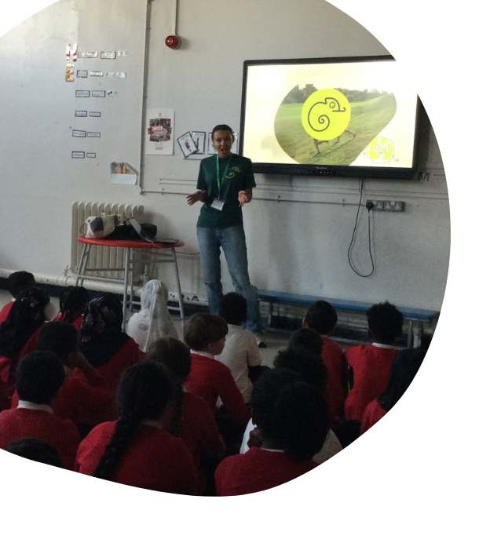
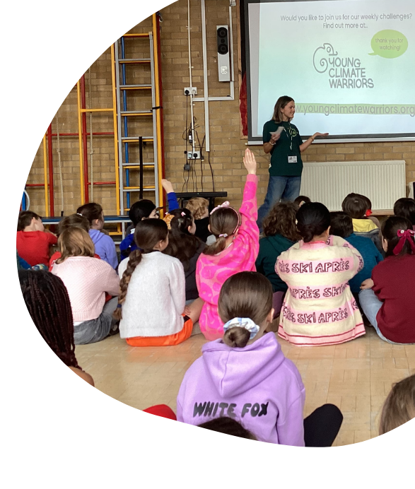

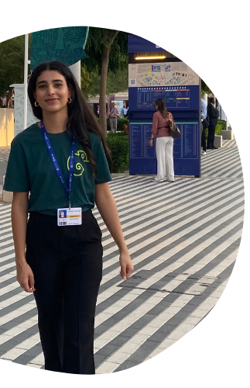

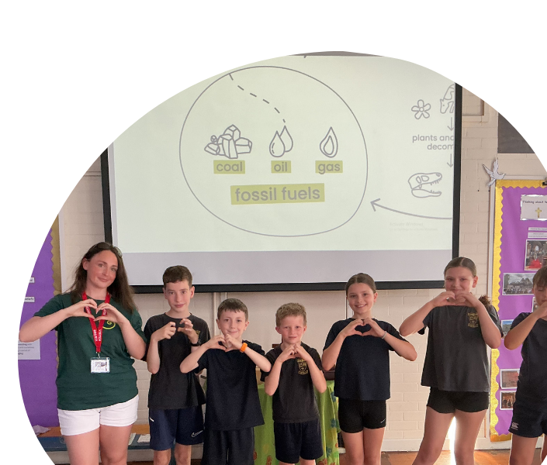
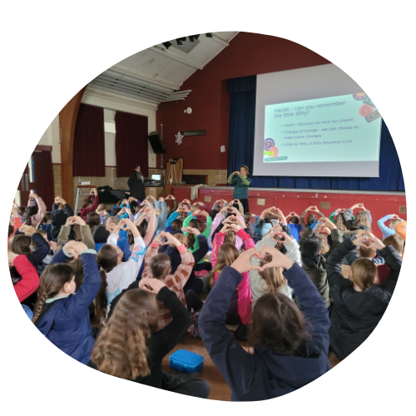
Your YCW
Ambassador!
Notes:
Ambassador delivery tips:
Skip this slide due to time constraints
ACTIVITY: Abstract Art – Climate Change – as a ’super-wicked problem’
Maybe set a time limit … the ‘strands’ are endless!
For this activity it doesn’t matter whether the strands relate to:
The reasons why climate change is happening,
the physical effects or
the environmental, social and economic impacts or
(Some people might also include ‘solutions’)
Here are just a few examples:
Environmental reasons:
Burning too many fossil fuels
Cutting down too many trees – our carbon ’stores’
Releasing too much methane, and other greenhouse gases
GHGs making a ‘blanket’ around our planet
GHSs trapping more heat from the sun within our planet
Human reasons:
Over-consumption
Lack of care for our environment
Lack of value placed on our natural world
Pollution on our land and in our oceans
Physical effects:
Forest fires
Rising sea levels
Ocean acidification
Water shortages – droughts
Water excess - flooding
Extreme weather – more storms
Ice caps melting
Glaciers melting
Changes in the length and intensity of seasons
Changes in highest / lowest temperatures in a given location
Environmental Impacts
Landslides
Changes in growing seasons
Wildlife struggles with changes
Species extinction
Increased prevalence of pests
Social Impacts
Displacement, migration
Dis-satisfaction, unrest, conflict
Intensified competition for resources
Growing global inequalities
Water stress
Food insecurity, hunger
Security risks for women and girls – pre-existing inequalities exacerbated (Listed by the UN as one of the 5 ways the climate crisis impacts human security - https://www.un.org/en/climatechange/science/climate-issues/human-security#:~:text=Climate%20change%20intensifies%20competition%20over,resources%20are%20getting%20increasingly%20scarce.)
Economic Impacts
Property and infrastructure loss and damage
Supply-chain disruption
Price instability
Adaptation costs
Emergency recovery costs
Reduction in economic growth and GDP

Slide 5



Scrap paper intro
What do you know about climate change and our natural world?
Your name
Draw an image
/write a word
Notes:
Ambassador delivery tips:
If pupils struggle to come up with any ideas, you can suggest the following:
Examples of words children may use:
Complicated
Confused
A mess
Mixed up
Why might we use this to represent the problem of climate change?
Not an easily solved problem
Lots of different opinions
Can be extremely confusing to understand fully
Multi-cultural
Multi-faceted

Slide 6



Climate change as a ball of wool …
’Simple problem’
follow the instructions to sort it.
Eg. Boil an egg.
‘Complicated problem’
needs some thought
and discussion.
Eg. Buying the best car for your family.
‘Super-complicated problem
solution involves lots of people, lots of countries, lots of different actions needed.
Eg. Climate change, or solving world hunger.
Notes:
Ambassador delivery tips:
Try to relate this as much as possible to their experiences in school. You might like to ask if they can think of any other examples of Traditional problems or Wicked problems once you have shared the examples with them.
There is no need to read out all the examples from the 'super-wicked' problem section. This is just to help explain why it is such a complex problem.
A TRADITIONAL PROBLEM - can be defined and has clear solutions – like a scientific experiment –
Examples: Solving a multiplication question like 2x4
A WICKED PROBLEM – is one that is more complicated with a range of solutions
For example, a school debate e.g. Should we wear school uniform?
A SUPER-WICKED PROBLEM – is one where the solutions are many, varied and complex
Some people say that Climate Change could be called a ‘super-wicked’ problem. (as is – solving world hunger, reducing global inequality – in fact all the Sustainable Development Goals are good examples!)
There are lots of reasons – but here are a few: -
VARIED SOLUTIONS - Climate change has so many varied solutions – many of which overlap, and all help towards the same goal – but how will we know the goal has been reached – it will be difficult to know when exactly enough has been done.
WHOLE WORLD - Never before has the whole world had to tackle something like climate change.
AFFECTS LOTS OF PEOPLE - LOTS OF “STAKEHOLDERS’ - Another reason why it is so complicated is due to the number of ‘stakeholders’ or ‘interested parties’ – let’s have a look at what that means.
In more detail - reasons why Climate Change could be referred to as a ‘Super - Wicked' Problem
Solutions to the climate crisis are not true or false, or good or bad. (it requires many value judgements)
Ordinary problems come with a limited set of potential solutions. Climate change doesn’t.
You can’t know when you’ve solved a problem under the climate change umbrella (how much do you need to reduce carbon emissions by to achieve less than 1.5 deg warming, what about unquantified feedback loops?)
Solutions to climate change generate unexpected consequences over time, making it difficult to measure their effectiveness. (even if temperature target or total quantity of carbon emissions reduction achieved – no knowing the local longer-term consequences – local warming etc)
Every solution we deploy will have irreversible consequences. (we can’t get back the monies or undo the physical infrastructure we use to combat climate change)
Climate change has no precedent, so experience won’t help you deal with it.
While ordinary problems are self-contained, climate change is mixed up with other problems, and doesn’t have one root cause.
Climate change involves many stakeholders, nearly all of whom have different ideas of the problem and its ideal solutions.
Problem-solvers are liable for the consequences of any actions they take because the actions will have a large impact. (Major obstacles include political accountability for potential impedance to economic growth resulting from attempts to protect the global commons, such as the atmosphere, oceans and glaciers)

Slide 7
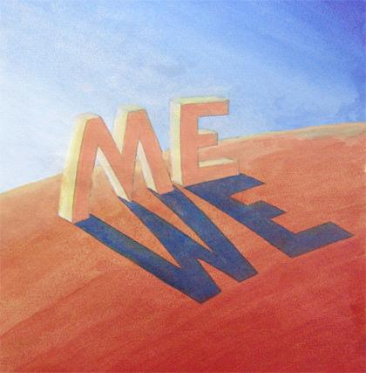

Looking after our planet needs teamwork.
Can you explain why climate change is like building a greenhouse around our planet?
Ball of wool
teamwork fun!
Notes:
Ambassador delivery tips:
This can be a really quick slide if time is running out!
Did you guess who else we haven’t talked about yet …
ME … WE … US
Individuals and how they respond, their choices and decisions can make a big difference.
There are many thousands of people and projects all around the world that are working to help combat climate change - It’s not just the ‘big names’ – there are lots of others.
How many small problems have you ALREADY solved even today?
How best to arrange your school books so you can get them out quickly?
What to play at break-time that works for all your friends?
Where to keep your socks so you can easily find them?
How to wipe your shoes effectively to you don’t muddy the carpet?
How to best take the core out of an apple?
Where to throw away you plastic recycling?
What community projects could YOU get involved in?
School – eco-council, nature club,
Town/City – litter-picking, scouts/cubs/brownies (taking eco-challenges)
Charity - WWF / other charity fundraisers – save a dolphin etc
Becoming a Young Climate Warrior – undertaking our Weekly Children’s Challenges!
When you grow up what problems would you like to solve?

Slide 8



Environmental problems …
What environmental problems have you heard of?
Can you explain why climate change is like building a greenhouse around our planet?
Notes:
Ambassador delivery tips (quick slide):
Explain to children that global action in relation to climate change is being driven by the United Nations. Has anyone heard of COP (Conference of Parties) before? Explain that every year, world leaders hold a huge meeting to plan how to fight climate change. It is called a COP, which stands for Conference of the Parties (United Nations Framework Convention on Climate Change). Leaders, scientists, and activists will gather to make plans for slowing climate change and protecting people, animals, and nature.
COP30 was held in Belem, Brazil – November 2025
COP31 – Probably Antalya, Australia – November 2026
COP32 – Expected to be held in an African country
196 countries signed the Paris Agreement in 2015 committing their countries to reducing their National emissions and helping the planet adapt to the impacts of climate change.
The Intergovernmental Panel on Climate Change (IPCC) is the United Nations body for assessing the science related to climate change – and comprises over 400 scientists from all over the world.

Slide 9
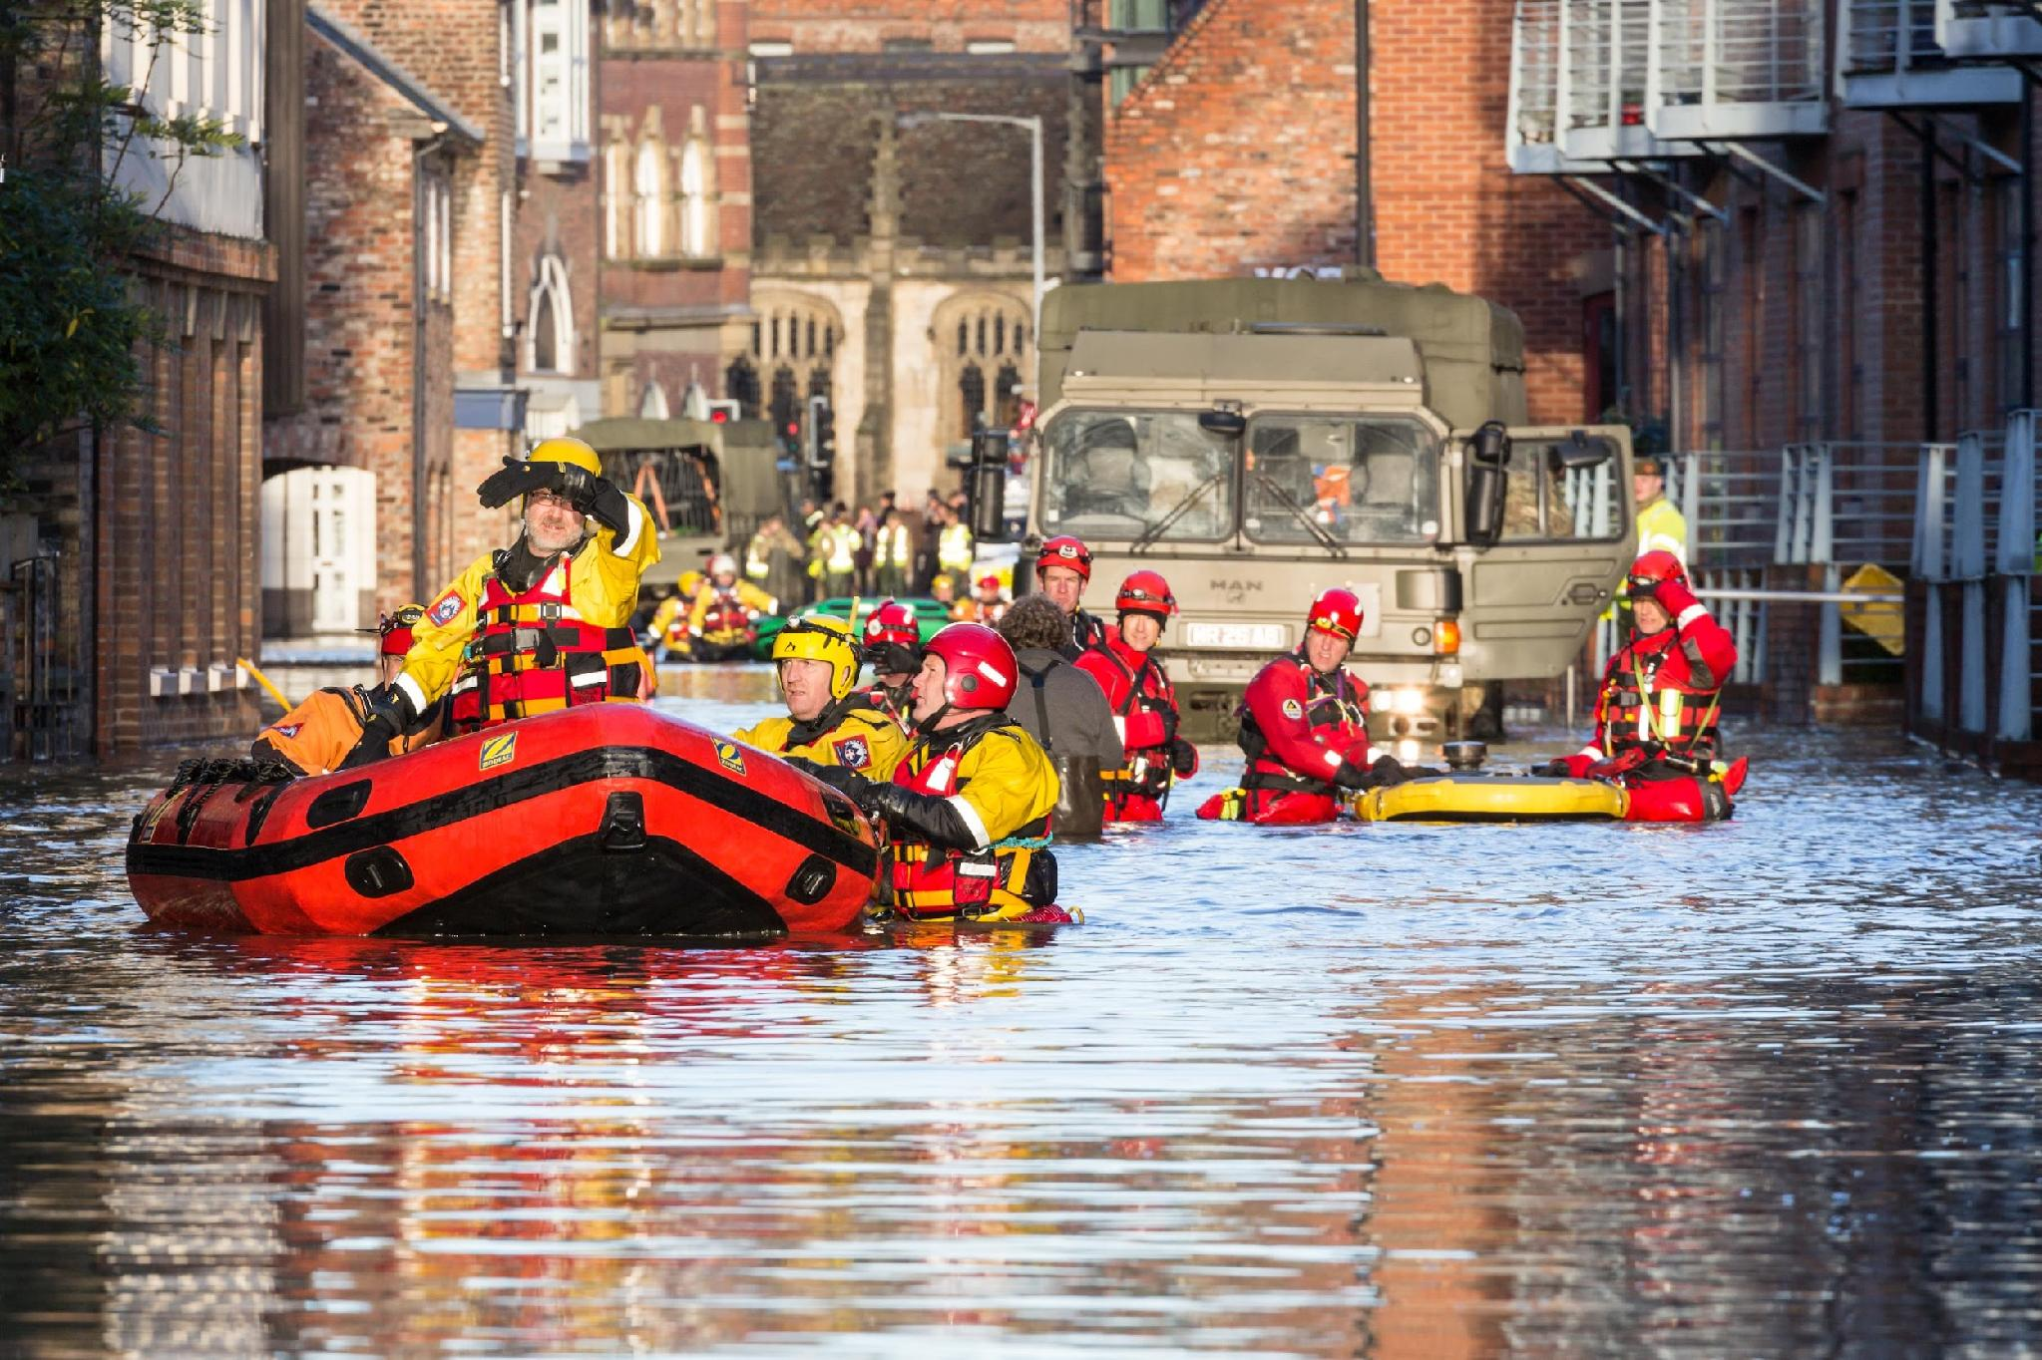
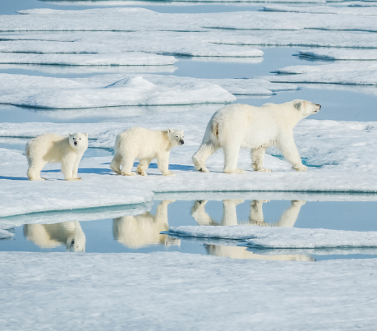
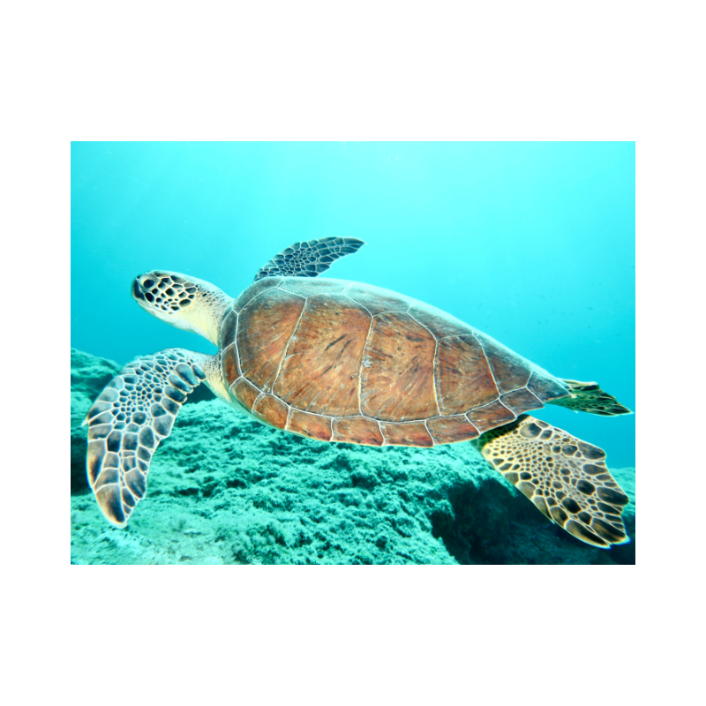
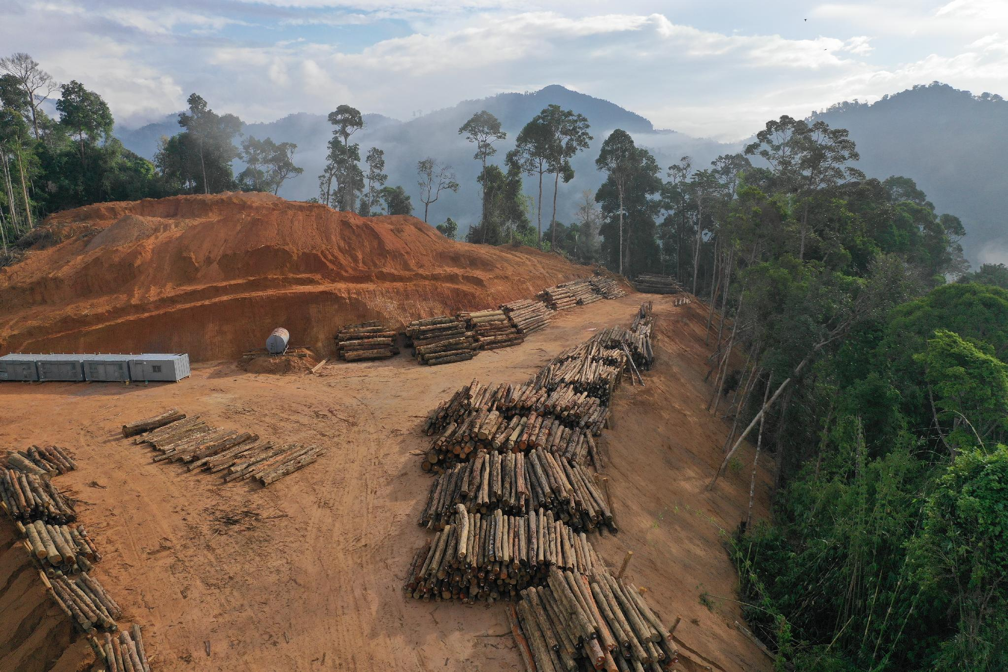
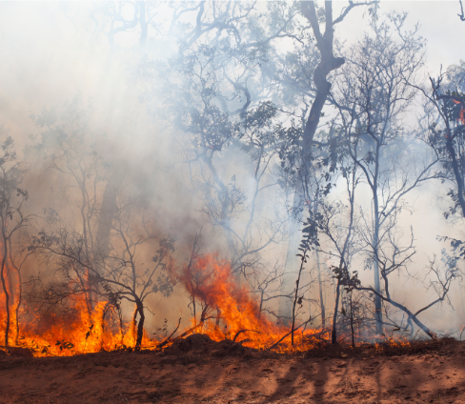
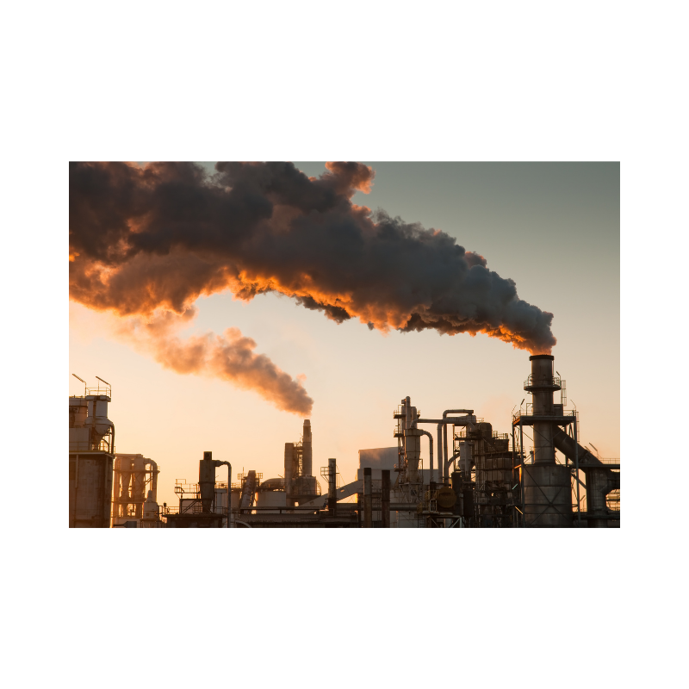
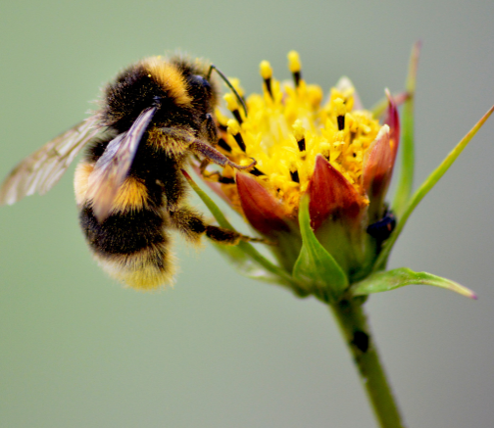
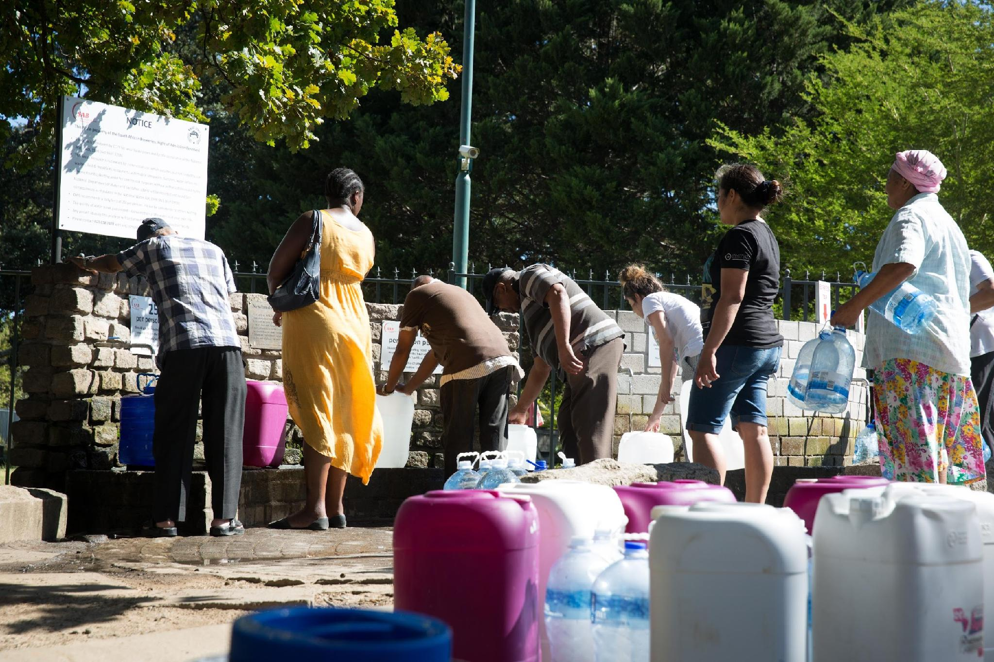
The problem … climate change is affecting communities around the world.
.
Notes:
Ambassador delivery tips:
Give pupils time to discuss with a partner then choose 2-3 to discuss in detail. Focus on the community and how they would feel about this.
Here are images of some of the climate change ‘effects’ … these all relate to water issues.
Resilience to climate change differs between communities – how do the people in York feel compared to those in Bangladesh?
How do the people on low-lying Pacific Islands feel?
The same PROBLEM of climate change has very differing IMPACTS across the world, depending on the actual physical impacts, but also dependent on the ‘preparedness’ or ‘resilience’ of the community.
PICTURE 1 – Lifeboats in York - Climate change is impacting life in the UK – Here is a picture of recent flooding in York, but we are fortunate to have well-organized and well-equipped emergency services to help us.
PICTURE 2 - Here is a photo of rickshaw drivers struggling with extreme levels of rainfall in Bangladesh
PICTURE 3 – Wildfire
Wildfires in Europe – Suffolk, France, Spain – Summer 2026
PICTURE 4 - Mabul Island, Malaysia. Islands like this are endangered by climate change and rising sea levels
Mabul Island is just one example of some of the very low-lying islands. Mabul only covers 20 hectares and is between 2 – 3metres above sea level.
There are 38 countries designated by the United Nations as Small Island Developing States – these are some of the countries most affected by climate change and rising sea levels.
PICTURE 5 – In 2018 there were severe water shortages in South Africa – you may remember hearing about them in the news.
This meant that people had to queue at standpipes at the end of their streets to get water.
They could no longer just ‘switch on the tap’ – like we are so used to being able to do –
Can you imagine having to worry about every drop of water you use?

Slide 10

Who can help solve the climate change problem?
Notes:
Ambassador delivery tips:
If pupils struggle to come up with any ideas, you can suggest the following:
Examples of words children may use:
Complicated
Confused
A mess
Mixed up
Why might we use this to represent the problem of climate change?
Not an easily solved problem
Lots of different opinions
Can be extremely confusing to understand fully
Multi-cultural
Multi-faceted

Slide 11
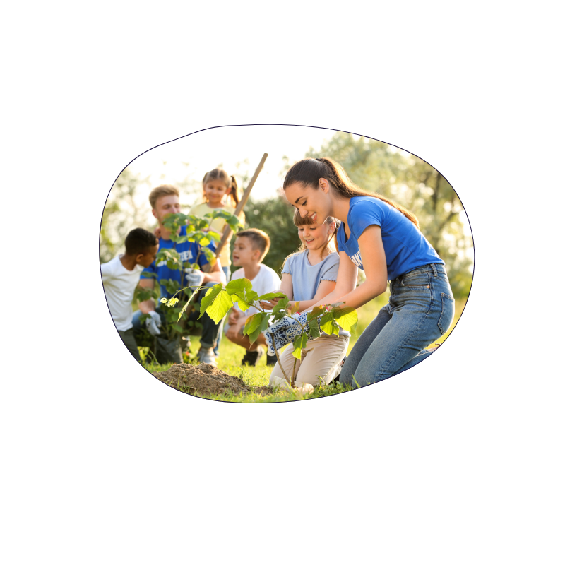
Who can help solve the climate change problem?
Notes:
Ambassador delivery tips:
If pupils struggle to come up with any ideas, you can suggest the following:
Examples of words children may use:
Complicated
Confused
A mess
Mixed up
Why might we use this to represent the problem of climate change?
Not an easily solved problem
Lots of different opinions
Can be extremely confusing to understand fully
Multi-cultural
Multi-faceted

Slide 12
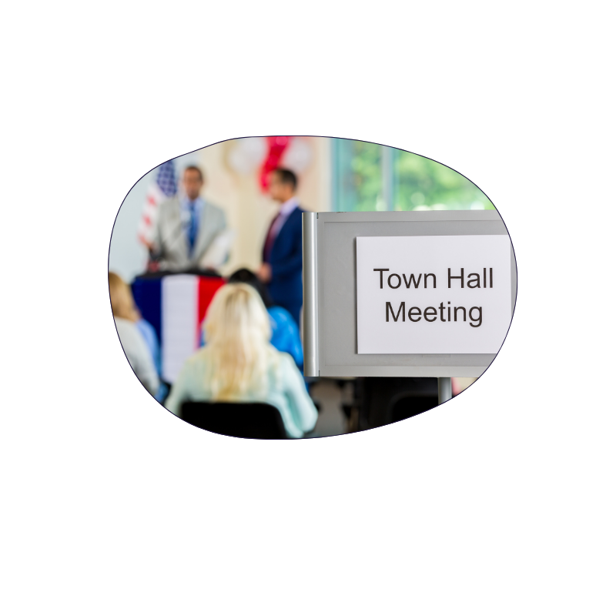
Who can help solve the climate change problem?
Notes:
Ambassador delivery tips:
If pupils struggle to come up with any ideas, you can suggest the following:
Examples of words children may use:
Complicated
Confused
A mess
Mixed up
Why might we use this to represent the problem of climate change?
Not an easily solved problem
Lots of different opinions
Can be extremely confusing to understand fully
Multi-cultural
Multi-faceted

Slide 13

Who can help solve the climate change problem?
Notes:
Ambassador delivery tips:
If pupils struggle to come up with any ideas, you can suggest the following:
Examples of words children may use:
Complicated
Confused
A mess
Mixed up
Why might we use this to represent the problem of climate change?
Not an easily solved problem
Lots of different opinions
Can be extremely confusing to understand fully
Multi-cultural
Multi-faceted

Slide 14

Who can help solve the climate change problem?
Notes:
Ambassador delivery tips:
If pupils struggle to come up with any ideas, you can suggest the following:
Examples of words children may use:
Complicated
Confused
A mess
Mixed up
Why might we use this to represent the problem of climate change?
Not an easily solved problem
Lots of different opinions
Can be extremely confusing to understand fully
Multi-cultural
Multi-faceted

Slide 15
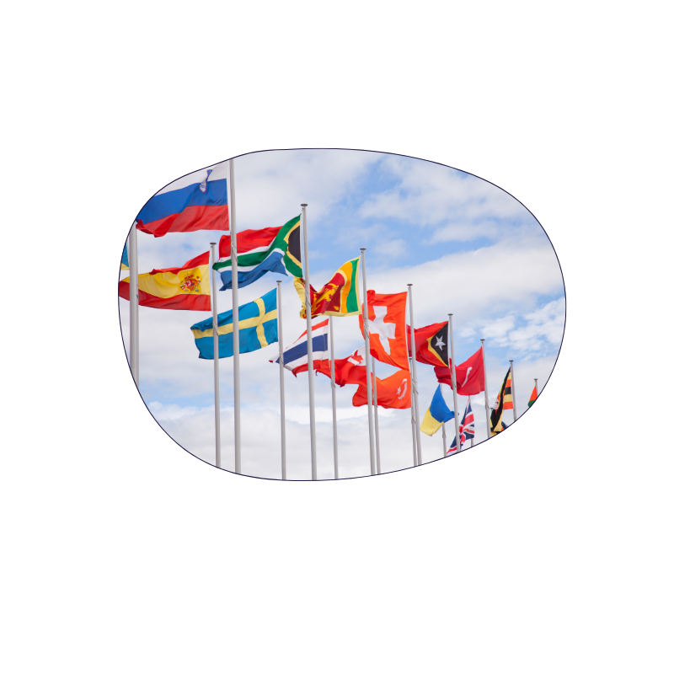
Who can help solve the climate change problem?
Notes:
Ambassador delivery tips:
If pupils struggle to come up with any ideas, you can suggest the following:
Examples of words children may use:
Complicated
Confused
A mess
Mixed up
Why might we use this to represent the problem of climate change?
Not an easily solved problem
Lots of different opinions
Can be extremely confusing to understand fully
Multi-cultural
Multi-faceted

Slide 16

Who can help solve the climate change problem?
Notes:
Ambassador delivery tips:
If pupils struggle to come up with any ideas, you can suggest the following:
Examples of words children may use:
Complicated
Confused
A mess
Mixed up
Why might we use this to represent the problem of climate change?
Not an easily solved problem
Lots of different opinions
Can be extremely confusing to understand fully
Multi-cultural
Multi-faceted

Slide 17

Who can help solve the climate change problem?
Notes:
Ambassador delivery tips:
If pupils struggle to come up with any ideas, you can suggest the following:
Examples of words children may use:
Complicated
Confused
A mess
Mixed up
Why might we use this to represent the problem of climate change?
Not an easily solved problem
Lots of different opinions
Can be extremely confusing to understand fully
Multi-cultural
Multi-faceted

Slide 18

Who can help solve the climate change problem?
Notes:
Ambassador delivery tips:
If pupils struggle to come up with any ideas, you can suggest the following:
Examples of words children may use:
Complicated
Confused
A mess
Mixed up
Why might we use this to represent the problem of climate change?
Not an easily solved problem
Lots of different opinions
Can be extremely confusing to understand fully
Multi-cultural
Multi-faceted

Slide 19
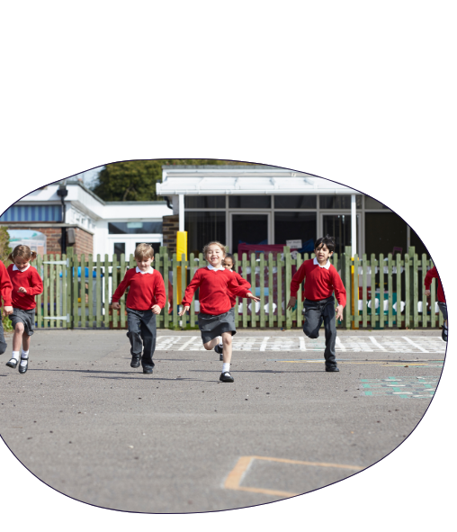
‘Humans are the greatest problem solvers our planet has ever known! Sir David Attenborough.
Notes:
Ambassador delivery tips:
If pupils struggle to come up with any ideas, you can suggest the following:
Examples of words children may use:
Complicated
Confused
A mess
Mixed up
Why might we use this to represent the problem of climate change?
Not an easily solved problem
Lots of different opinions
Can be extremely confusing to understand fully
Multi-cultural
Multi-faceted

Slide 20


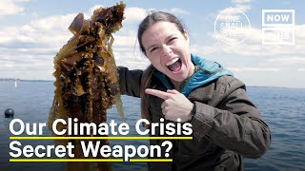

A cool problem-solving project!
Film clip
Watch this ‘seaweed’ film
Do you think these seaweed ideas seem sensible or crazy?
Would you like to be involved in these sorts of projects when you’re older?
https://www.youtube.com/watch?v=PECyAWqTgtc
Notes:
Ambassador delivery tips:
Ask the children first to raise their hands if they have seen seaweed on the beach. Explain that some people are now finding different ways to use seaweed to reduce our carbon emissions.
Watch the video -
Seaweed as a food - https://youtu.be/LIK71UMFqw8.
Pose the question: Do you think this seaweed idea seems sensible or crazy? Give children the opportunity to talk about this with a partner first.
Climate change means we need to change the way we do things – our behaviours. Both to prevent further damage – ie reducing our carbon emissions to help prevent the worst impacts of climate change, but also to help us manage and cope with existing and future impacts.
Would you like to be involved in these sorts of projects when you are older?
Who might want to be a scientist or engineer in the future …?

Slide 21

Stand up … if
You have …
You know someone who has …
Can you explain why climate change is like building a greenhouse around our planet?
Notes:
Ambassador delivery tips (quick slide):
Explain to children that global action in relation to climate change is being driven by the United Nations. Has anyone heard of COP (Conference of Parties) before? Explain that every year, world leaders hold a huge meeting to plan how to fight climate change. It is called a COP, which stands for Conference of the Parties (United Nations Framework Convention on Climate Change). Leaders, scientists, and activists will gather to make plans for slowing climate change and protecting people, animals, and nature.
COP30 was held in Belem, Brazil – November 2025
COP31 – Probably Antalya, Australia – November 2026
COP32 – Expected to be held in an African country
196 countries signed the Paris Agreement in 2015 committing their countries to reducing their National emissions and helping the planet adapt to the impacts of climate change.
The Intergovernmental Panel on Climate Change (IPCC) is the United Nations body for assessing the science related to climate change – and comprises over 400 scientists from all over the world.

Slide 22



Be part of the solution … not part of the problem … be a climate change problem-solver!
What can we do?
Fill in your own ‘Climate Action’ jigsaw.
Notes:
Ambassador delivery tips:
This is the main activity of the session. Linking to the last slide, ask children to discuss ideas for actions they could take – at home or at school. Feedback and consider writing some of these ideas down where all children can view them if they run out of ideas. If this is an eco council session, ask children to think about what their aims for the eco club are. What would they like to achieve this year?
Ask the teacher if they can share photos of their completed jigsaw pages by email with Young Climate Warriors.
Examples:
Individual:
Turn off lights
Walk/cycle more
Recycle at home
Turn off electronic devices
Don't leave devices plugged in
Talk to family/friends about climate change
Join Young Climate Warriors!
Donate old toys/clothes instead of throwing away
School:
Reduce the amount of food waste
Use less plastic in school
Save electricity
Install more recycling bins
Talk to class about climate change
Grow our own fruit/vegetables
Try more plant-based recipes
Fill in the blank jigsaw with climate actions.

Slide 23

Notes:
ACTIVITY: Blank jigsaw puzzle sheet to print out

Slide 24




Learning from today …
Takeaway
Action!
Put up your jigsaw puzzle at home – on your fridge, on your bathroom mirror?
Choose ONE climate action from your jigsaw that YOU can do this week … starting today!
Notes:
Ambassador delivery tips: please do encourage children to email YCW to let us know if they have undertaken the ‘takeaway action’ and/or to share a photo of their completed jigsaw.
THIS IS YOUR WEEKLY CHALLENGE!!!
Following each CCC in a Box session there is challenge – for you to take home.
If you tell us that you have completed a challenge by EMAILING – CCCinabox@youngclimatewarriors.org – then we will acknowledge your email, and we can provide certificates for those that complete 3 challenges!!! (our 3 challenge award!)

Slide 25
Together we are stronger.
Can you be brave …
Can you be courageous…
Can you be brave…
Can you be courageous …
Can you explain why climate change is like building a greenhouse around our planet?
Notes:
Ambassador delivery tips:
This can be a really quick slide if time is running out!
Did you guess who else we haven’t talked about yet …
ME … WE … US
Individuals and how they respond, their choices and decisions can make a big difference.
There are many thousands of people and projects all around the world that are working to help combat climate change - It’s not just the ‘big names’ – there are lots of others.
How many small problems have you ALREADY solved even today?
How best to arrange your school books so you can get them out quickly?
What to play at break-time that works for all your friends?
Where to keep your socks so you can easily find them?
How to wipe your shoes effectively to you don’t muddy the carpet?
How to best take the core out of an apple?
Where to throw away you plastic recycling?
What community projects could YOU get involved in?
School – eco-council, nature club,
Town/City – litter-picking, scouts/cubs/brownies (taking eco-challenges)
Charity - WWF / other charity fundraisers – save a dolphin etc
Becoming a Young Climate Warrior – undertaking our Weekly Children’s Challenges!
When you grow up what problems would you like to solve?

Slide 26
Additional slides
Notes:
ACTIVITY: Blank jigsaw puzzle sheet to print out

Slide 27
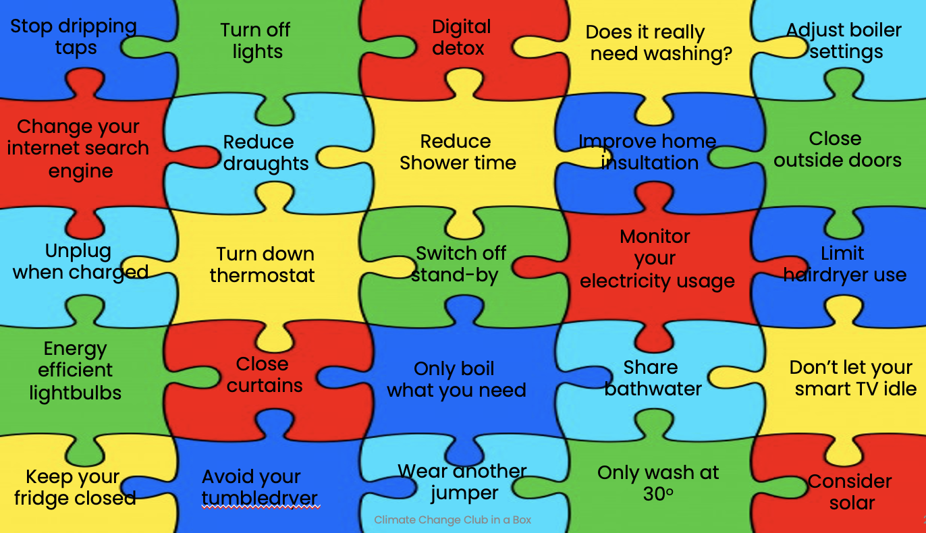
Notes:
Ambassador delivery tips:
This is the main activity of the session. Linking to the last slide, ask children to discuss ideas for actions they could take – at home or at school. Feedback and consider writing some of these ideas down where all children can view them if they run out of ideas. If this is an eco council session, ask children to think about what their aims for the eco club are. What would they like to achieve this year?
Ask the teacher if they can share photos of their completed jigsaw pages by email with Young Climate Warriors.
Examples:
Individual:
Turn off lights
Walk/cycle more
Recycle at home
Turn off electronic devices
Don't leave devices plugged in
Talk to family/friends about climate change
Join Young Climate Warriors!
Donate old toys/clothes instead of throwing away
School:
Reduce the amount of food waste
Use less plastic in school
Save electricity
Install more recycling bins
Talk to class about climate change
Grow our own fruit/vegetables
Try more plant-based recipes
Fill in the blank jigsaw with climate actions.

Slide 28
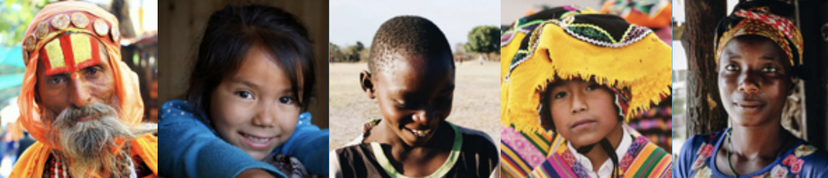
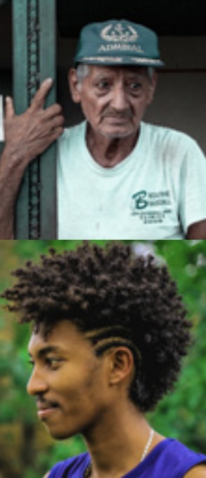
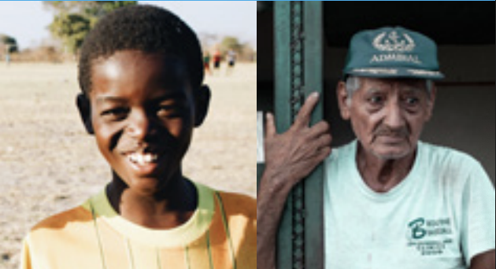
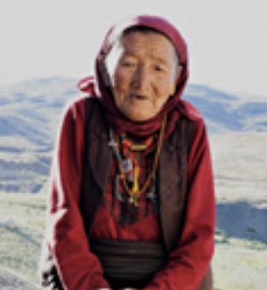
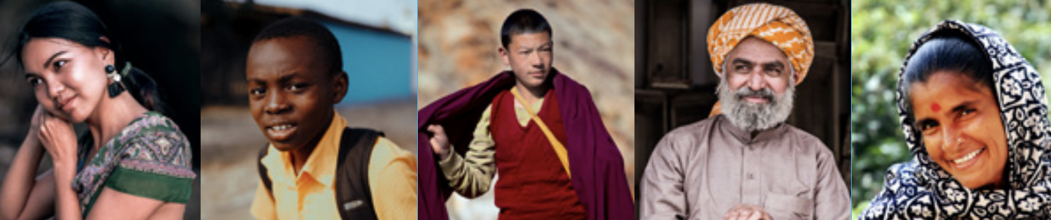
Indigenous Entrepreneurs …
We live in an amazing world, full of amazing people.
Action can be both ‘small scale’ or ‘large scale’.
*Imagery and quote - UNFCCC report – energizing entrepreneurs tackling climate change.
Notes:
Ambassador delivery tips:
Ask a student to read out the quote. What do you think about this quote? Ask for responses from 2-3 children. Explain that change can happen at different scales – from small scale actions like reducing consumption … to larger scale actions like creating a business.
Explain to children that Indigenous peoples protect much of nature through knowledge passed down over generations.
However, they also increasingly require technology to adapt to a changing climate – but this technology can act as a temporary ‘plaster’ rather than a long-term solution. Indigenous peoples account for 5% of the world’s population. Yet their traditional land practices protect 80% of biodiversity, and play an outsized role in slowing climate change.
Examples of Indigenous projects:
In Bangladesh, people have created floating gardens that adapt to rising floodwaters and ensure food security in increasingly vulnerable areas.
Kayapo people in Brazil have preserved one of the largest Indigenous-managed rainforests in the world, sequestering some 1.3 billion metric tons of CO₂ through their sustainable land management practices.
On the next slide, we are going to have a look at another indigenous entrepreneur.

Slide 29

Local community ‘problem-solvers’ …
Activity!
Work with your classmates and complete a spider diagram of local climate change problem-solvers!
Who are your ‘role models’?
‘Many hands make light work’
A 14th century English proverb
Communities: groups of individuals working together, can achieve great things!
Notes:
Ambassador delivery tips:
Spend around 5 minutes on this.
ACTIVITY: Local ‘problem-solvers’
Complete together on flipchart/whiteboard.
Many hands make light work – is a 14th century English idiom (proverb/expression/saying), that means ‘ many helpers can make a task easier to accomplish.
And this is certainly true when tackling an issue the size and complexity of climate change. There are literally thousands of people involved – all around the world!
If we all work together and take small steps then overall we can have a big impact. - Lots of small actions = one big action = ‘Little by little, a little can become a lot’
Working as a community is a great way to galvanise individuals – who are the people in your local community who are helping solve our climate change problem? Children to discuss and feedback. There are examples below if children struggle to come up with ideas.
Ideas of local climate change problem-solvers
Teachers
Re-fill shop assistants
Electricians installing energy efficient appliances
Wildlife rangers
Scouts group tree planting
Community litter pickers
Insulation installers
Solar panel manufacturers
Gardeners
Wildflower planting group
Farmers
Second—hand shop volunteers

Slide 30


Global ‘problem-solvers’ …
Does anyone know in which country the next big Climate Change Conference – or COP - is taking place?
Can you explain why climate change is like building a greenhouse around our planet?
Have you heard of these organisations – do you know anything about them?
Notes:
Ambassador delivery tips (quick slide):
Explain to children that global action in relation to climate change is being driven by the United Nations. Has anyone heard of COP (Conference of Parties) before? Explain that every year, world leaders hold a huge meeting to plan how to fight climate change. It is called a COP, which stands for Conference of the Parties (United Nations Framework Convention on Climate Change). Leaders, scientists, and activists will gather to make plans for slowing climate change and protecting people, animals, and nature.
COP30 was held in Belem, Brazil – November 2025
COP31 – Probably Antalya, Australia – November 2026
COP32 – Expected to be held in an African country
196 countries signed the Paris Agreement in 2015 committing their countries to reducing their National emissions and helping the planet adapt to the impacts of climate change.
The Intergovernmental Panel on Climate Change (IPCC) is the United Nations body for assessing the science related to climate change – and comprises over 400 scientists from all over the world.

Slide 31
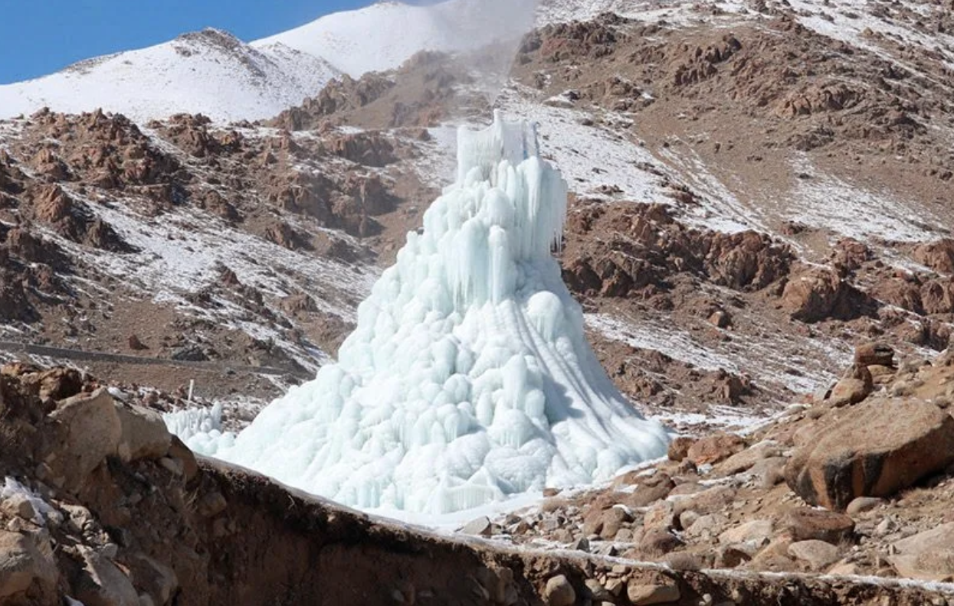
Ingenious Himalayan entrepreneur – designer of the ‘ice stupa’
Developed by Sonam Wangchuk, Ladakh, India, these ‘ice stupas’ enable Himalayan communities to store glacial fresh water melt during the winter for use during the arid summer months. With climate change and receding glaciers this helps provide much needed water in the springtime. Dozens of ‘ice stupas’ deliver millions of litres to local villages.
Here’s a link if you’d like to learn more.
Notes:
Ambassador delivery tips:
Explain to children that in this mountain-desert region of the Himalayas, they only have around 10cm of rain each year. Ask children why this would be a problem? Explain that this would make it very difficult to grow the crops that they need. An engineer called Sonam Wangchuk came up with an innovative solution to this. During the winter months, they freeze and store fresh water in huge, towering structures called ice stupas. They can then use this water during the spring planting season and throughout the year for the communities.
Video that teachers can show children at another time if they wish.
https://www.sciencefocus.com/planet-earth/artificial-glaciers
https://youtu.be/aBE-WQPBAUQ

